Slide 1
Automotive Manufacturing in the UK in 2014

Slide 2
Presentation to
Jaguar Land Rover
20th January 2015

Slide 3
Rimstock Plc Group
Founded in 1984
31 years of evolution
Customers in over 35 countries worldwide
Including 3 full owned subsidiaries in USA, Germany and France
Production capacity in excess of 10K cast wheels plus 700 x 3/5 axis milled forged wheels per week.
Approved OE supplier to over 30 manufacturers
Full in house Concept to Manufacture capability

Slide 4
Rimstock Plc Group
McLaren Automotive £1,739,000
Aston Martin Lagonda £1,309,000
Tyreline O.E. Ltd £1,169,000
Mitsubishi/Colt £1,149,000
Lotus Cars £923,000
TMC USA £835,000
Volkswagen Group £679,000
Autobrokers/Overfinch Ltd £601,000
Tesla Motors Inc. £565,000
Carlsson £436,000
PSA £381,000
Nissan International £317,000
Jaguar Land Rover £284,000
Global Sales 2013/2014 £17,272,000

Slide 5
Rimstock Business Plan / Vision for 2014/2015
 | Prior 2 Year Actual |  | 5 year Business plan
 | 2012/13 | 2013/14 | 2014/15 | 2015/16 | 2016/17 | 2017/18 | 2018/19
Forged units | 16,658 | 13,987 | 19,900 | 31,360 | 49,900 | 75,960 | 100,000
Cast units | 153,951 | 158,408 | 176,450 | 194,200 | 230,465 | 263,800 | 290,000
 | 170,609 | 172,395 | 196,350 | 225,560 | 280,365 | 339,760 | 390,000
Forged wheel turnover | 4,600,572 | 4,333,902 | 6,410,000 | 9,627,000 | 14,450,000 | 21,450,000 | 25,000,000
Cast wheel turnover | 9,263,116 | 9,942,829 | 10,650,000 | 11,970,000 | 13,165,000 | 16,500,000 | 18,375,000
Total Sales Budget inc Refurbs & Tyres | 15,146,700 | 15,132,541 | 18,175,000 | 23,000,000 | 29,217,000 | 39,720,000 | 45,344,000
Capital Investment Forecast (£)
Buildings |  |  | 525,000 | 30,000 | 20,000 | 100,000 | 200,000
Foundry |  |  | 255,000 | 415,000 | 380,000 | 240,000 | 255,000
Finishing Shop |  |  | 195,000 | 105,000 | 160,000 | 250,000 | 210,000
Machines |  |  | 812,000 | 1,177,000 | 2,235,000 | 2,370,000 | 2,774,000
Quality Control |  |  | 25,000 | 250,000 | 200,000
Infrastructure, tooling and anc equipt |  |  | 230,000 | 209,000 | 205,000 | 300,000 | 320,000
General inc forged tooling |  |  | 250,000 | 250,000 | 730,000 | 780,000 | 780,000
Forged wheel Development |  |  | 1,685,000 | 1,650,000
Total Investment Spend | 1,200,000 | 1,500,000 | 3,977,000 | 4,086,000 | 3,930,000 | 4,040,000 | 4,539,000

Slide 6
ETO Audit Status
ETO Audit Oct 2013
JLR visit & Rimstock Assessment Sept 2014
Visit by JLR STA team Oct 2014
Rimstock reassessment Jan 2015 (Verified as part of the external TUV/TS16949 renewal audit)

Slide 7
Audit October 2013

Slide 8
Re-assessment Sept 2014

Slide 9
Re-assessment Jan 2015

Slide 10
Original Equipment Customers
Alfa Romeo
Aston Martin
Bentley
Chrysler
Colt Car Company
Chevrolet
Ford
General Motors
Hyundai
Jaguar
Kia
Land Rover
Lotus
McLaren Automotive
Mitsubishi
Morgan
Nissan
Prodrive
PSA Peugeot Citroen
Renault
Rolls Royce
Spyker
Subaru
Tesla Motors
TRD
Tyreline O.E
Vauxhall
VWCV

Slide 11
Original Equipment Customers
Alfa Romeo
Aston Martin
Bentley
Chrysler
Colt Car Company
Chevrolet
Ford
General Motors
Hyundai
Jaguar
Kia
Land Rover
Lotus
McLaren Automotive
Mitsubishi
Morgan
Nissan
Prodrive
PSA Peugeot Citroen
Renault
Rolls Royce
Spyker
Subaru
Tesla Motors
TRD
Tyreline O.E
VWCV

Slide 12
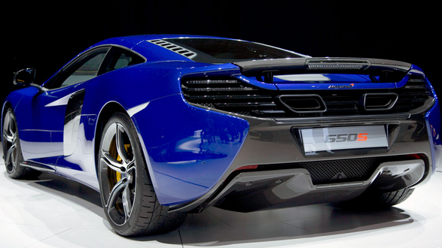
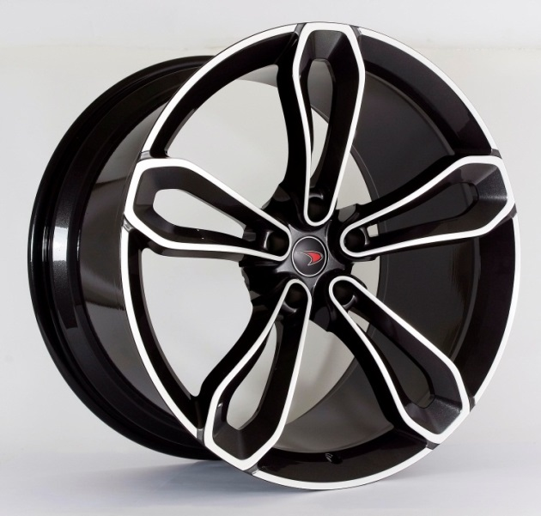
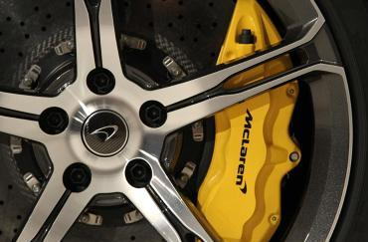
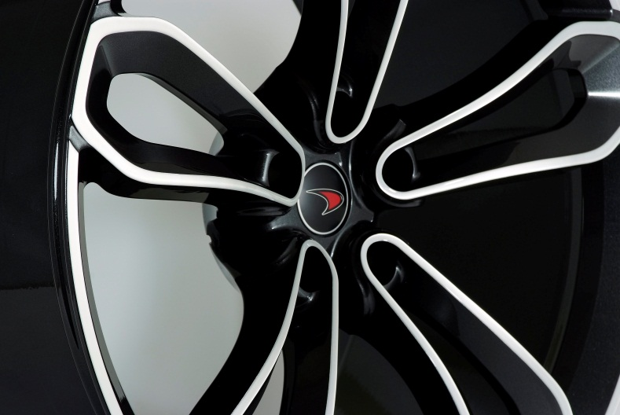
Original Equipment Customers

Slide 13
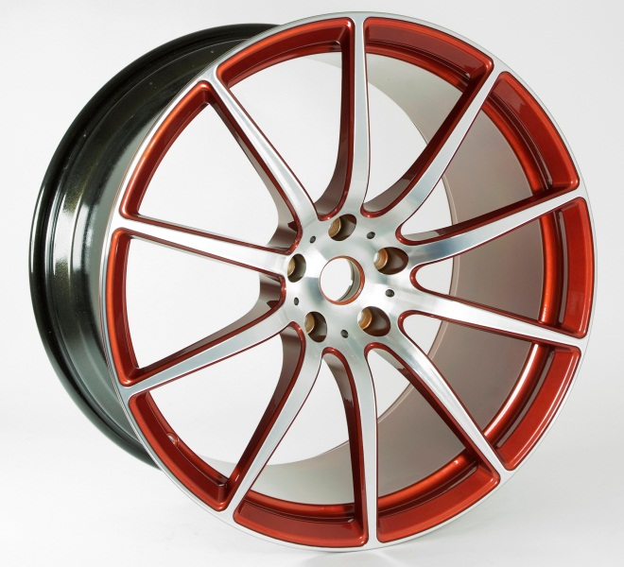
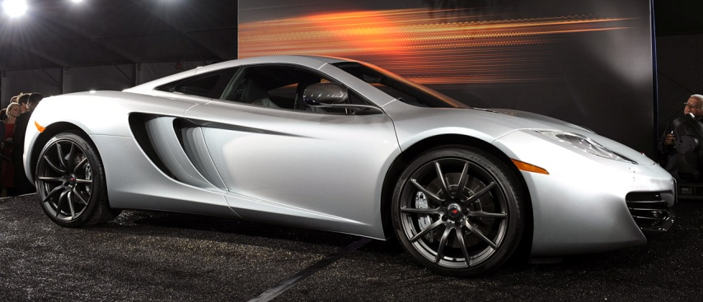
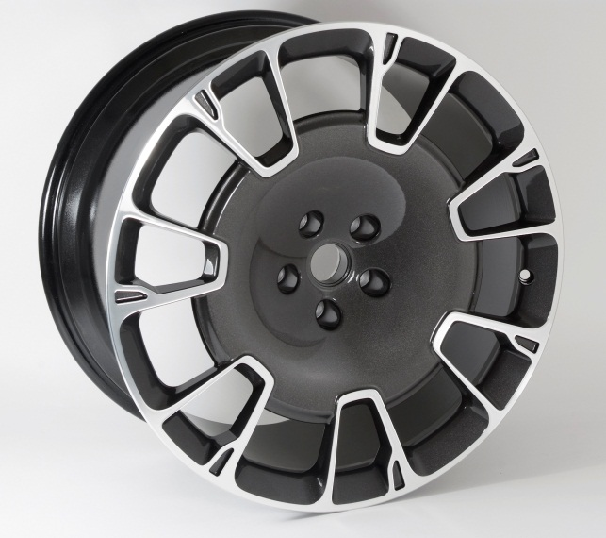
McLaren Special Operations

Slide 14
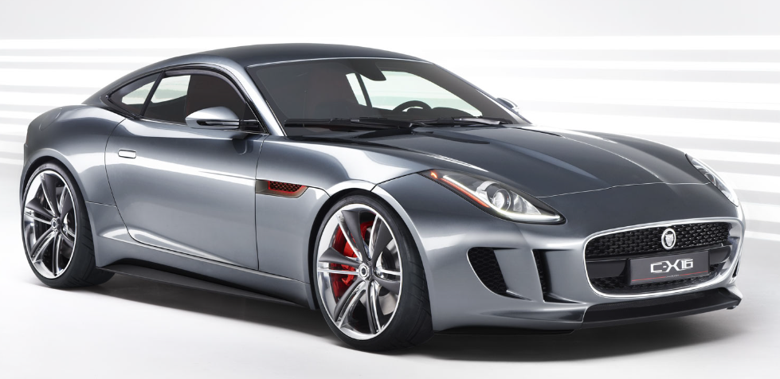
Original Equipment Customers
XK-RS

Slide 15
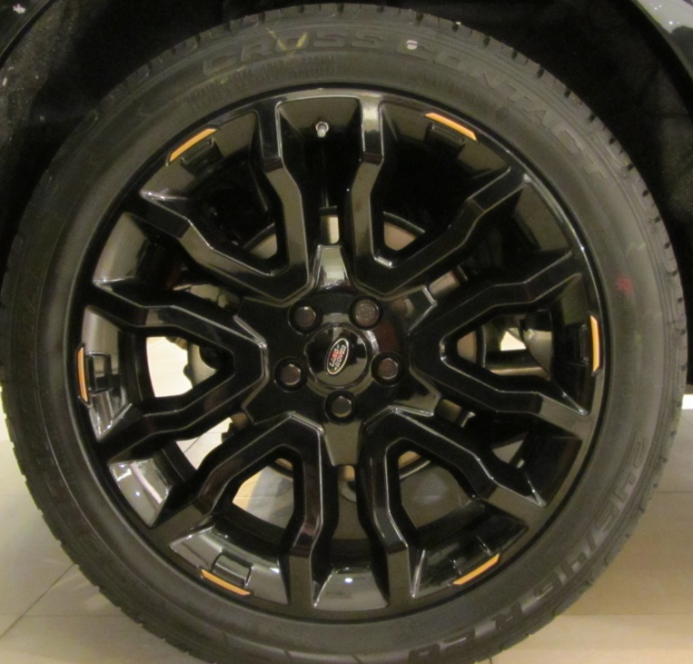
Original Equipment Customers
Special
Edition
Victoria Beckham Evoque

Slide 16
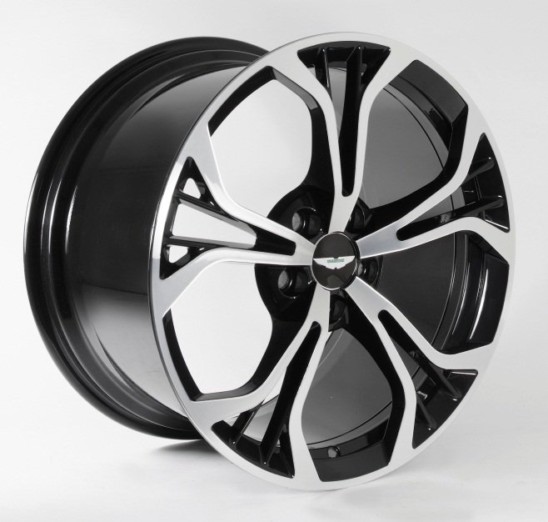
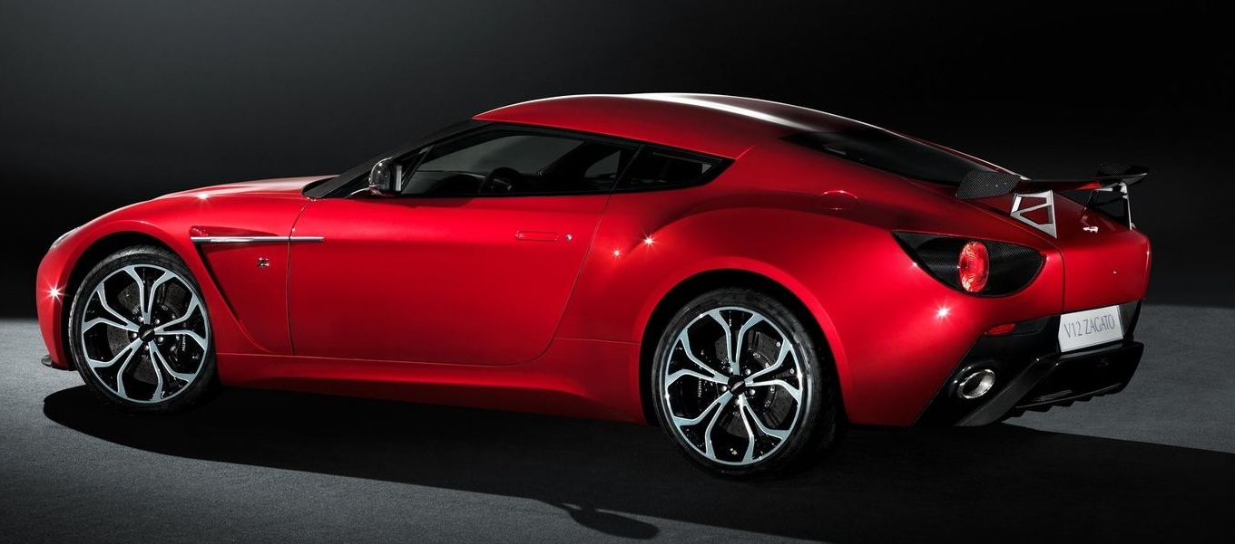
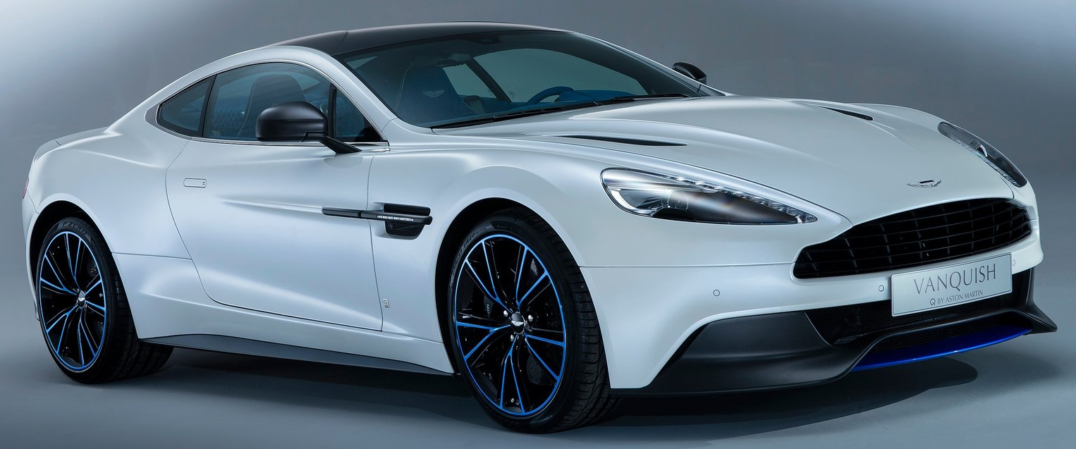
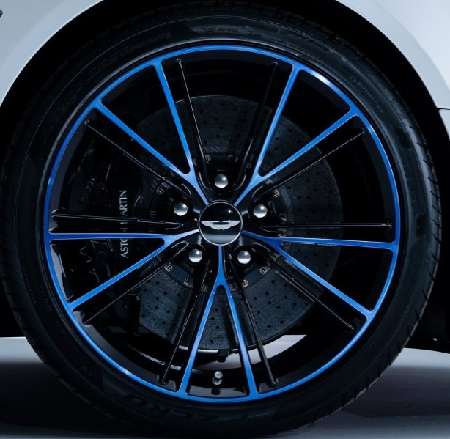
Original Equipment Customers

Slide 17
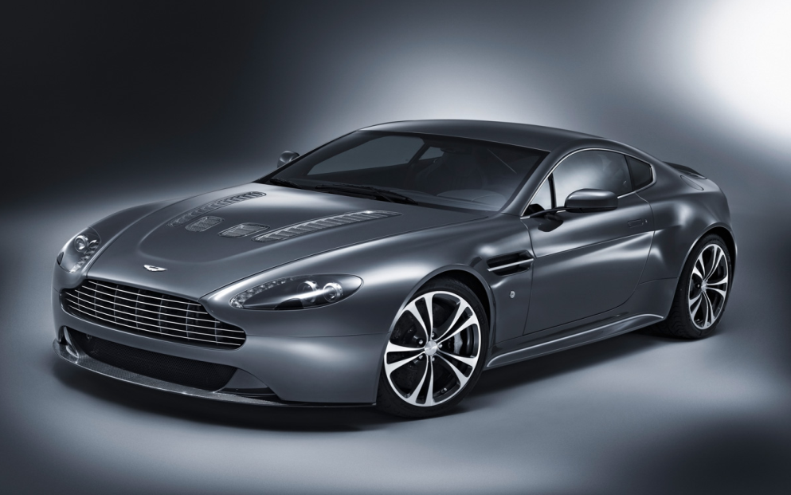
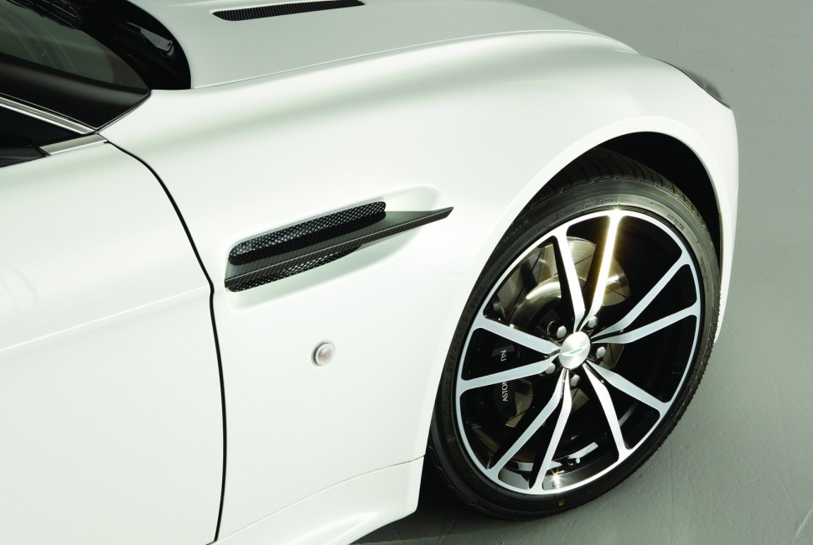
Original Equipment Customers

Slide 18
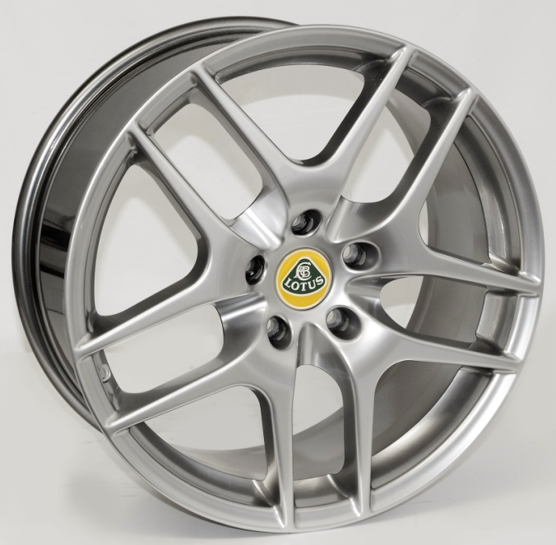
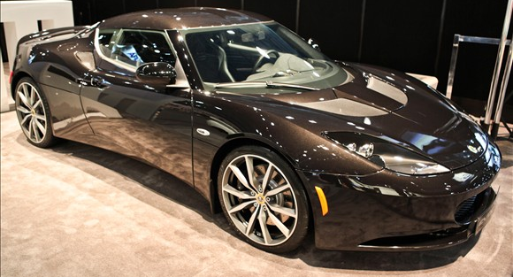
Original Equipment Customers

Slide 19
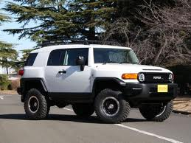
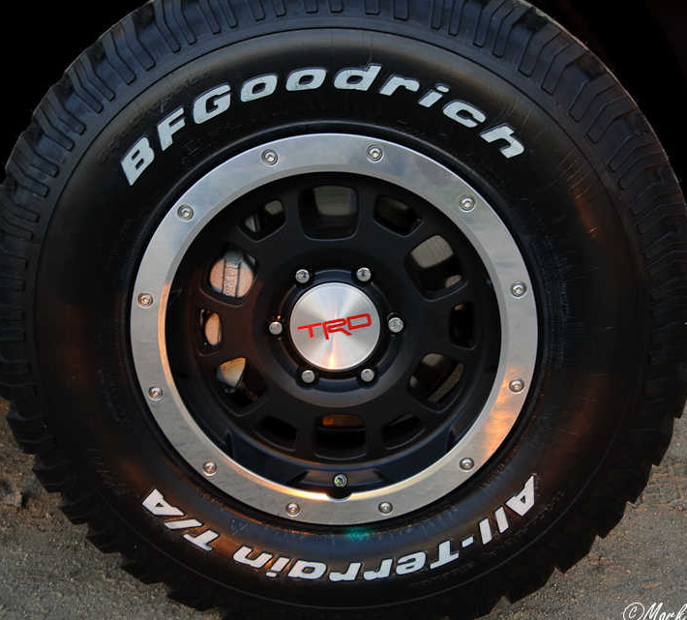
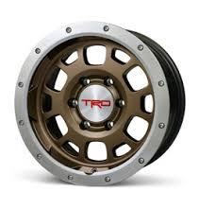
Original Equipment Customers

Slide 20
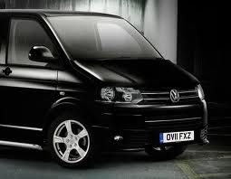
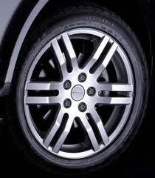
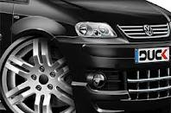
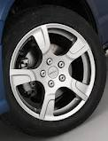
Original Equipment Customers

Slide 21
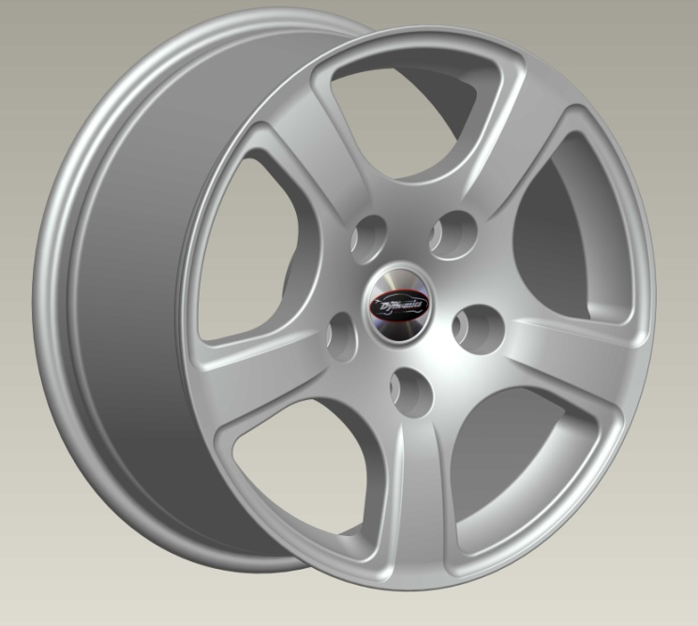
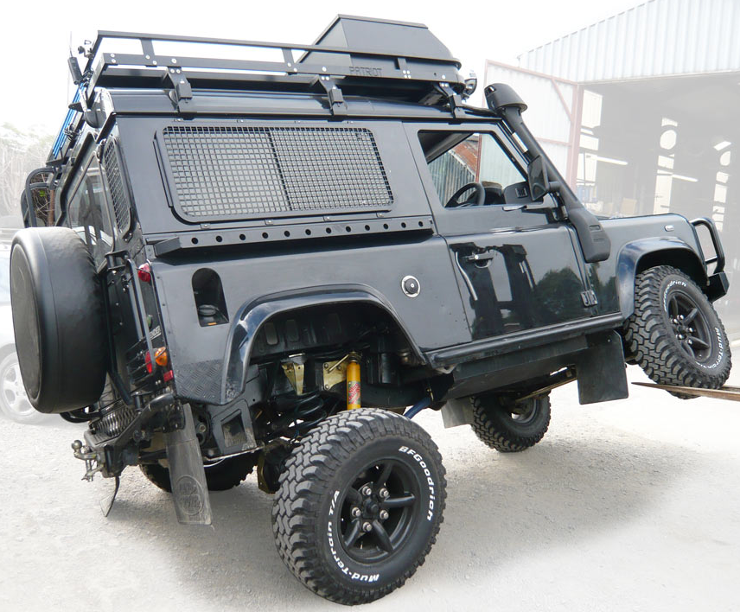
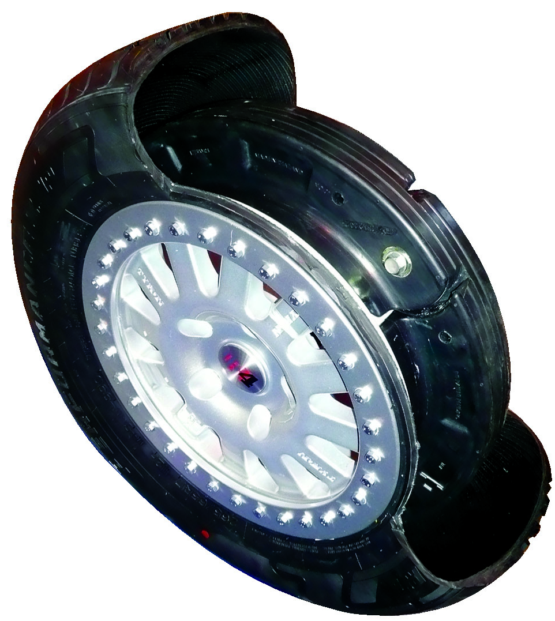
Security Applications
PSV Shield GmbH Zu Rims Tyron International
Full Bead Lock
Designed For Discreet Armoured Vehicles Or Military/Security Use, Each wheel Is Load Rated up to 1600kg And Fitted With A Run Flat system.
TUV Approved To 150km With All 4 Tyres Deflated

Slide 22
Specialist Customers & Tuners
ABT
ALFAHOLICS – ALFA ROMEO
CARLSSON
CATERHAM CARS
COSWORTH Ltd
J E ENGINEERING – LAND ROVER
MOBIS PARTS EUROPE
OVERFINCH– RANGE ROVER
PSV SHIELD – ARMOURED VEHICLES
TYRON INTERNATIONAL – MILITARY APPLICATIONS
WESTFIELD SPORTS CARS
ZU – LAND ROVER

Slide 23
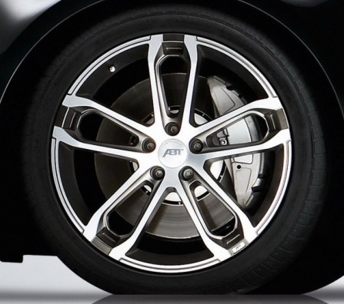
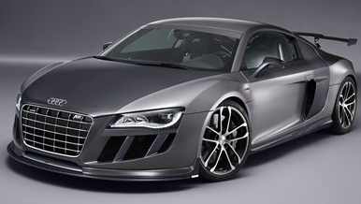
Tuner Customers

Slide 24
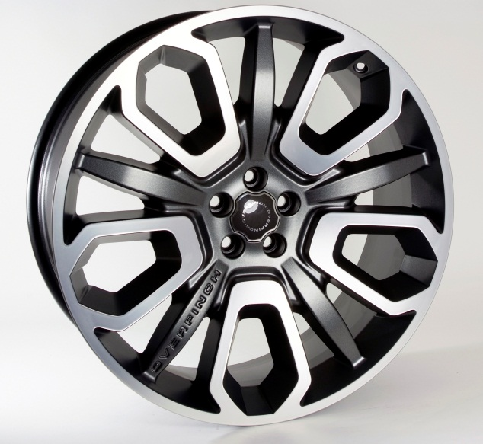
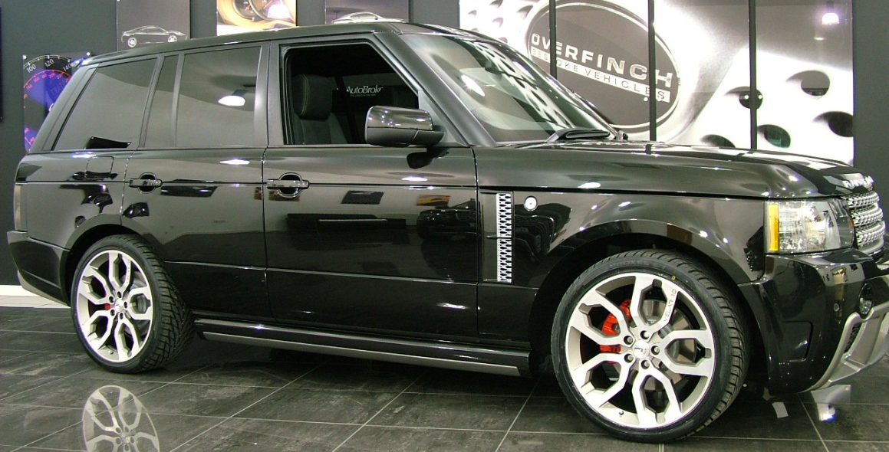
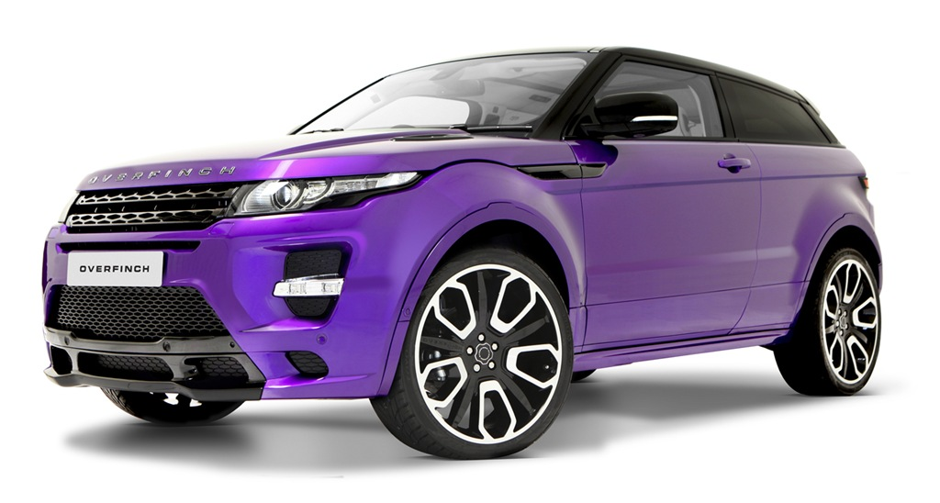
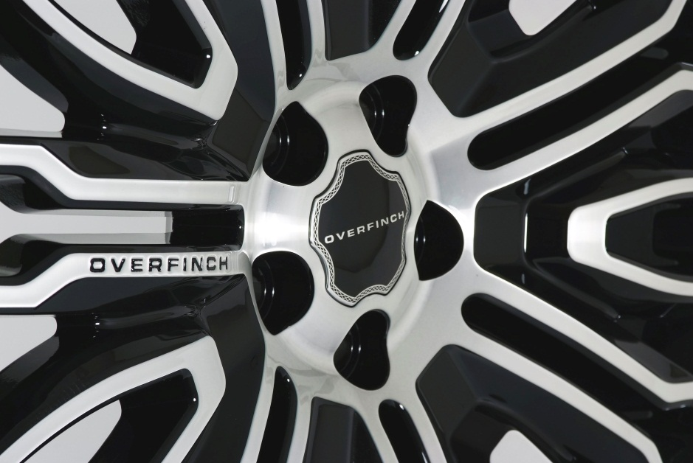
Tuner Customers

Slide 25
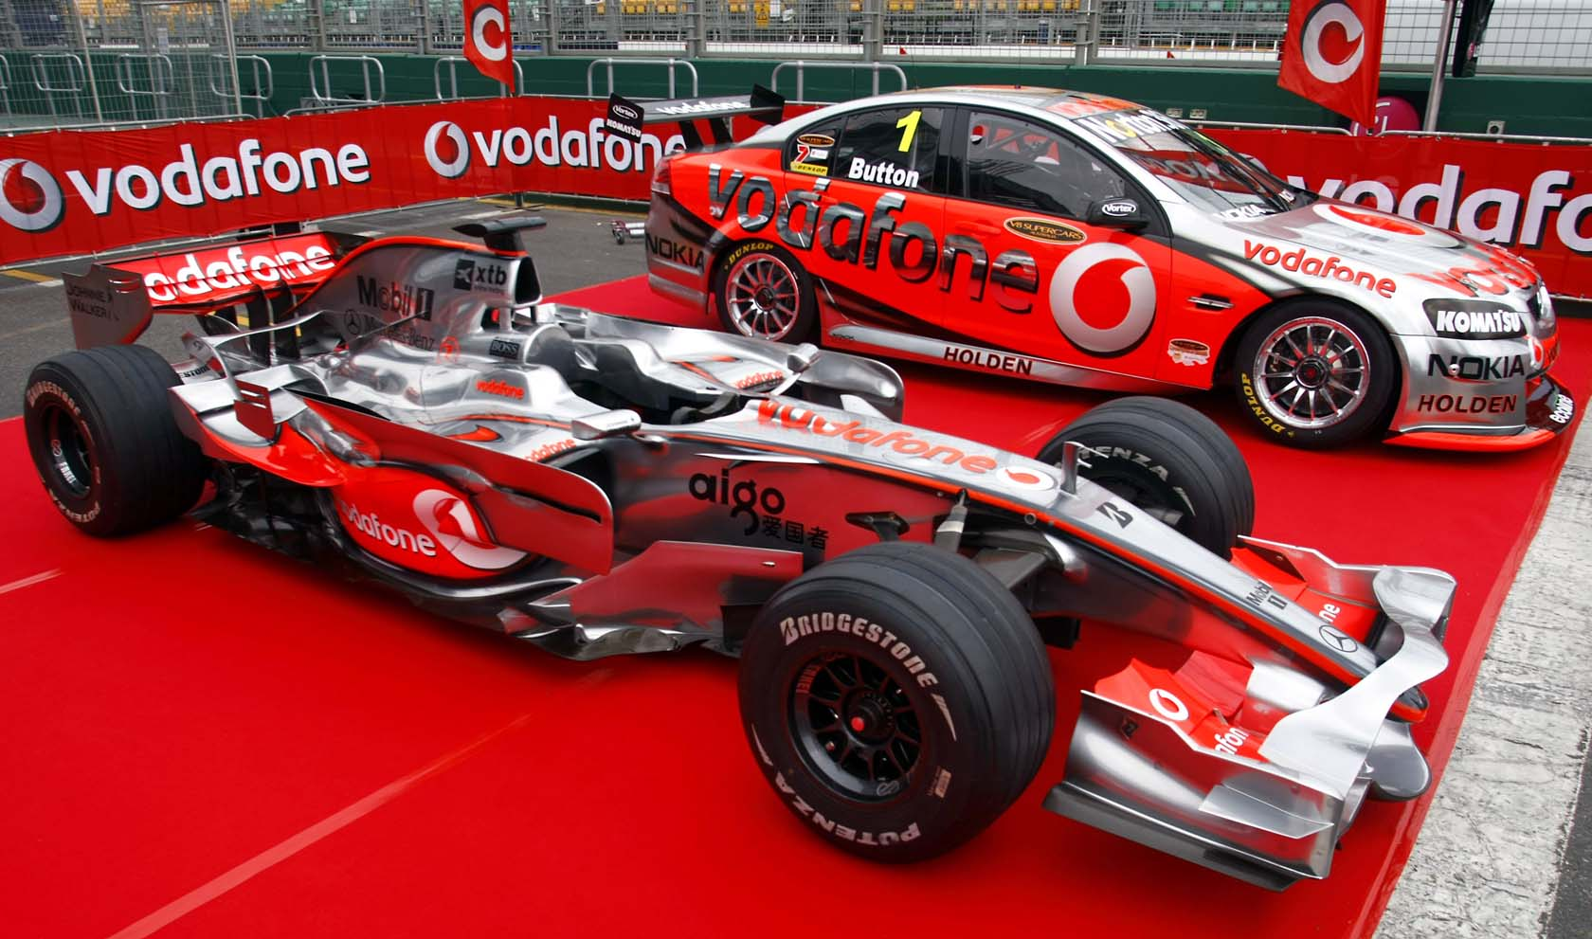
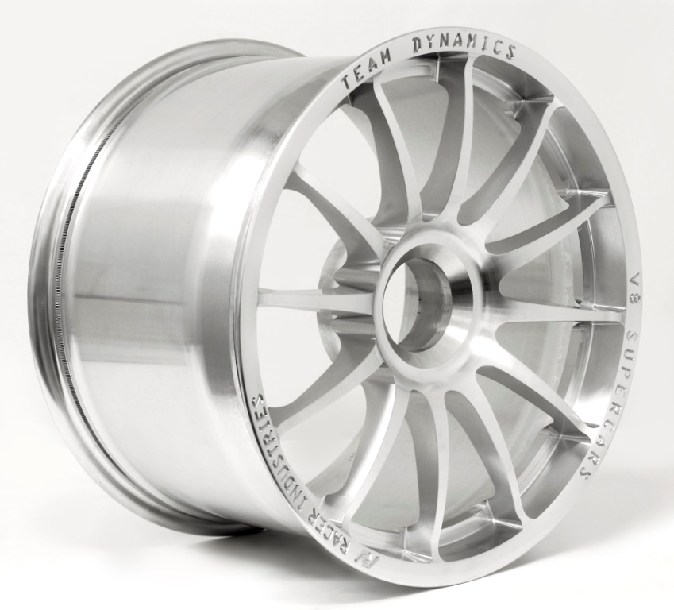
Team Dynamics Race Wheels
Australian V8 Supercar
Championship Wheel

Slide 26
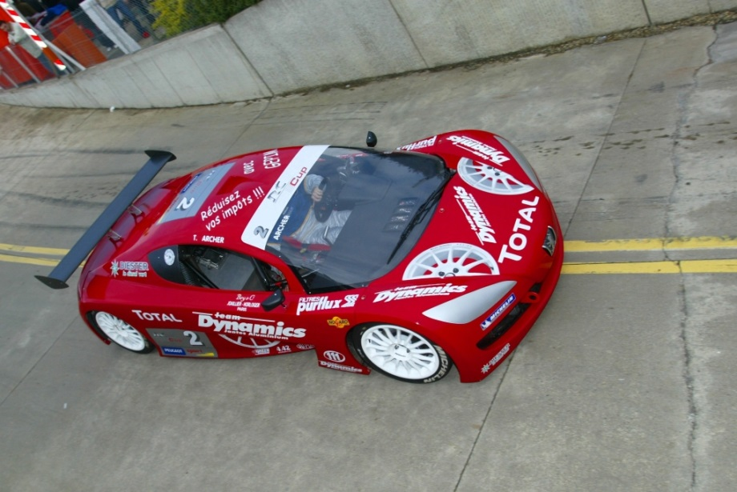
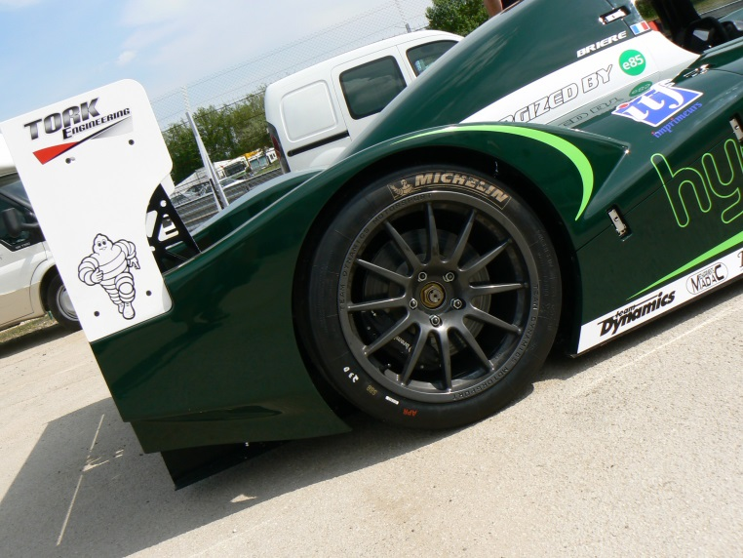
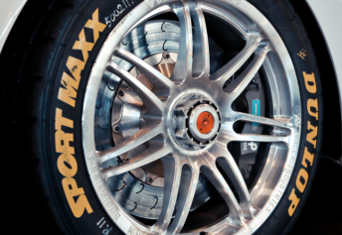
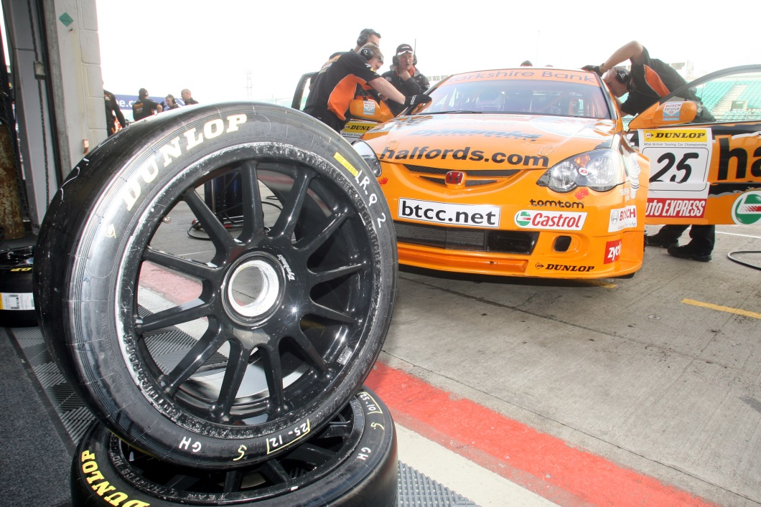
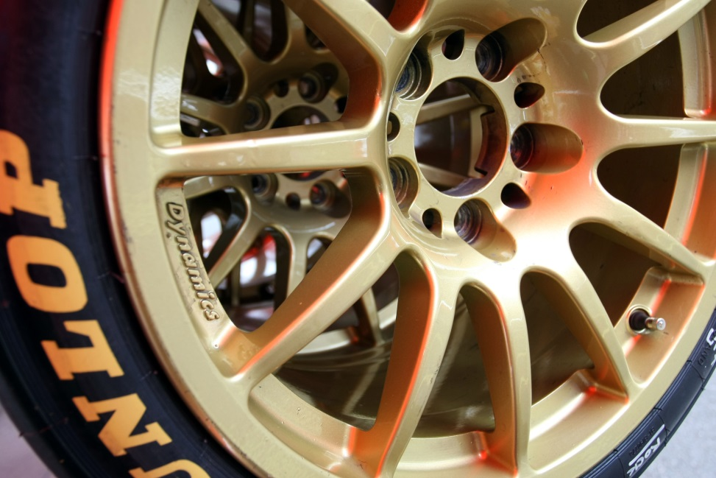
Team Dynamics Race Wheels

Slide 27
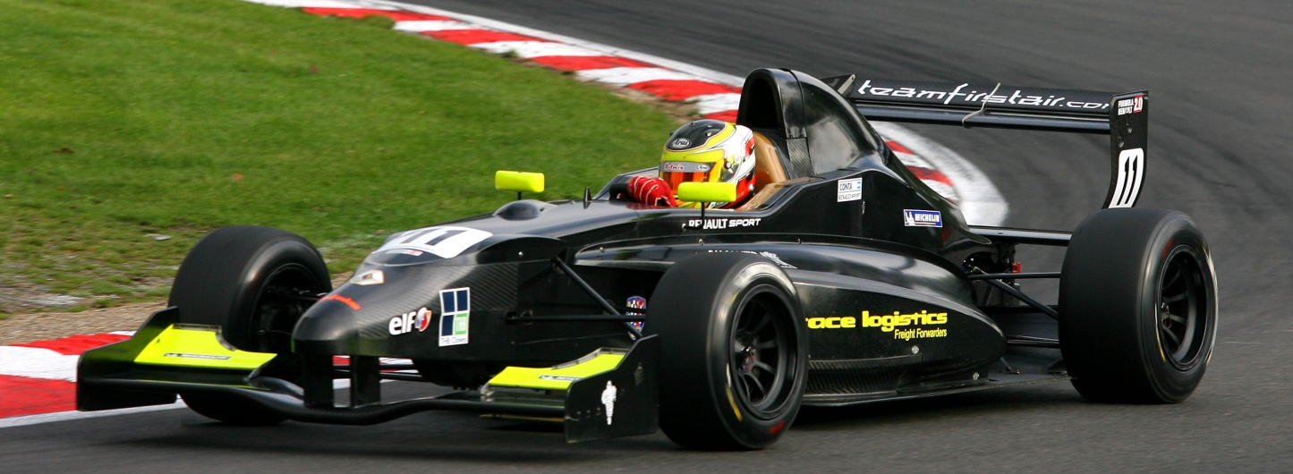
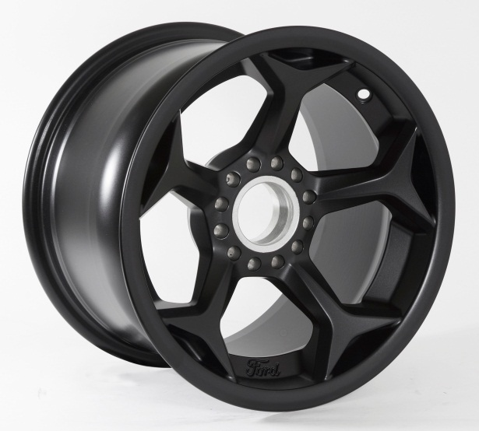
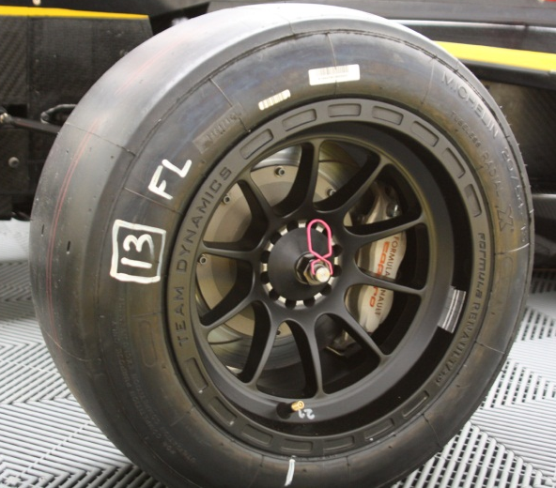
Formula Renault & Formula Ford

Slide 28
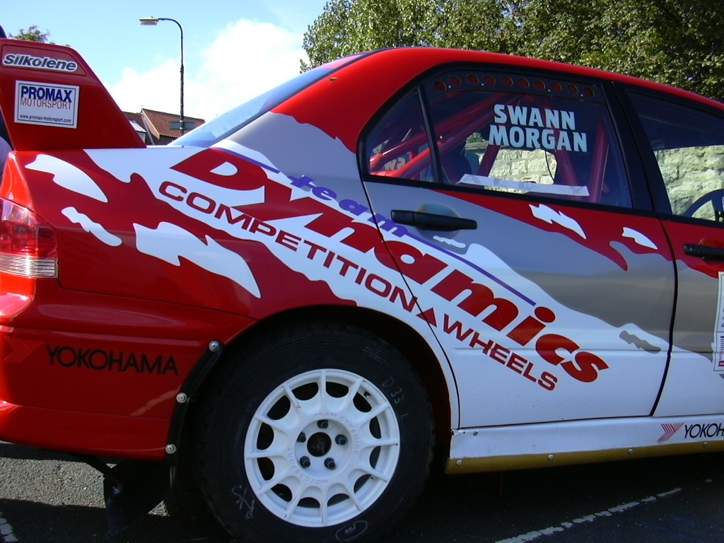
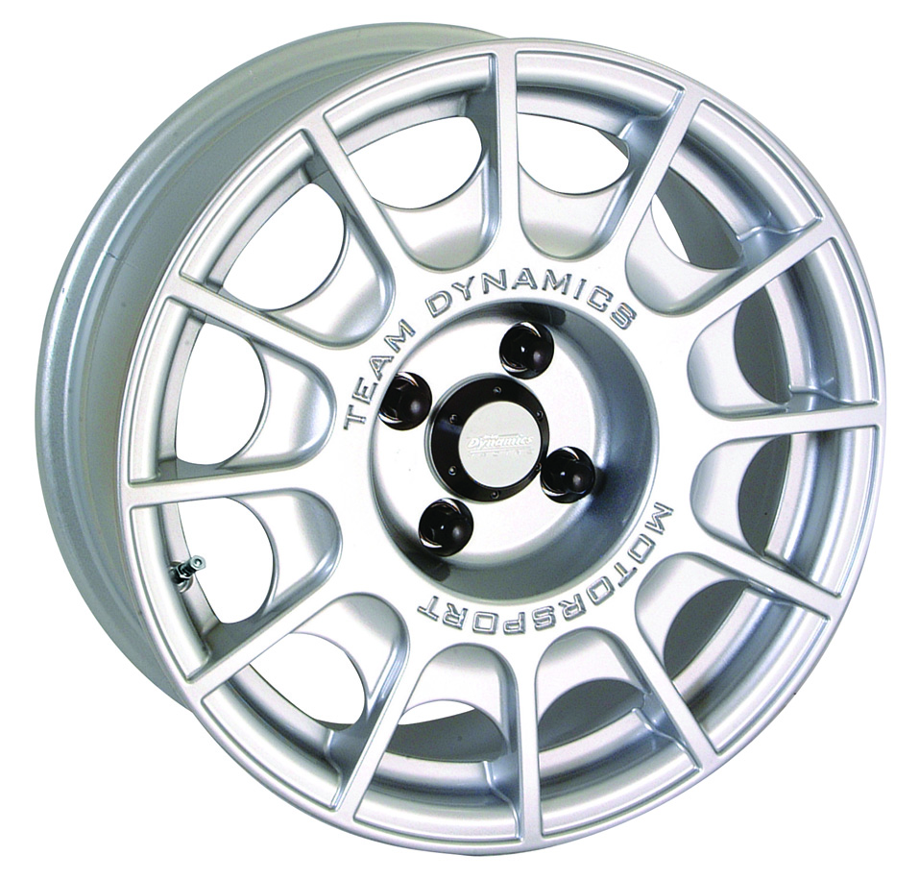
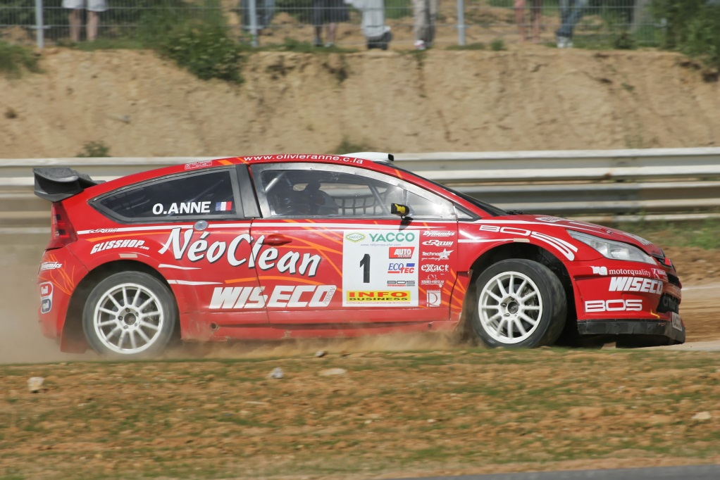
Team Dynamics Rally & Rally Cross Wheels

Slide 29
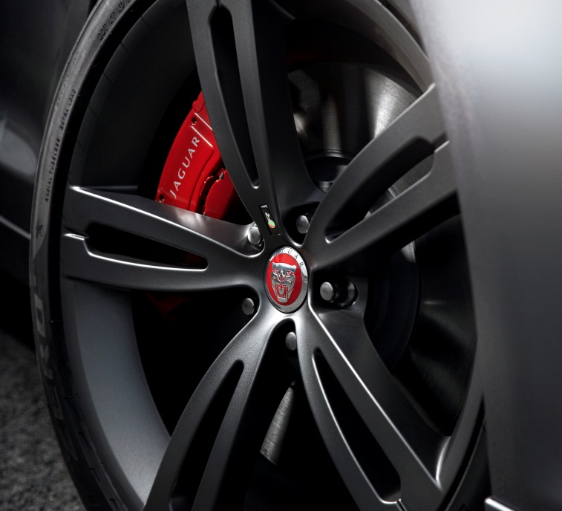
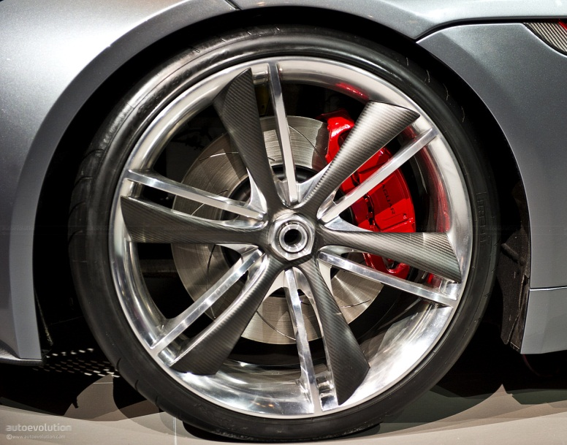
Concept Wheel Design

Slide 30
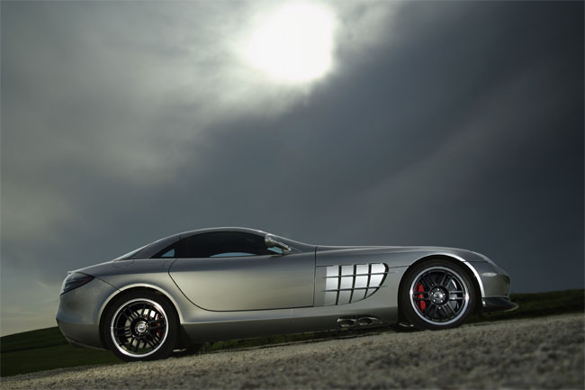
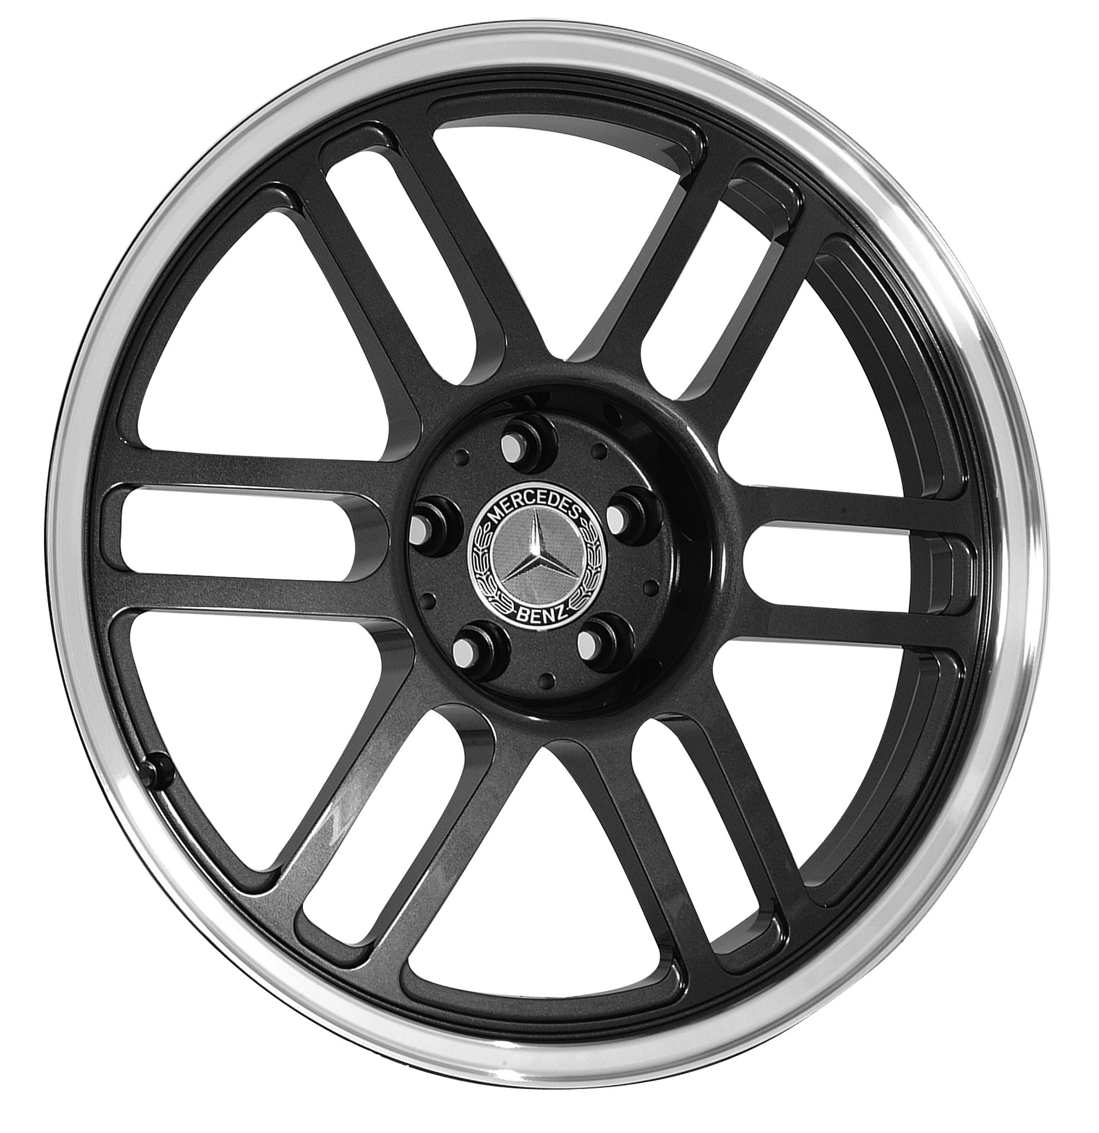
Concept Wheel Design
LRX Concept
OriginalSLR Concept

Slide 31
RAPID REACTION
Fast to market – scale and flexibility
Capability to progress from concept to first cast prototype in 10 weeks!
React to modern market demands and finish trends faster
Improved lead times and reduced costs
Future investment plans in development to increase capacity of both forged and cast wheel output

Slide 32
Rimstock Manufacturing
Seven key elements to product delivery
Conceptual Styling & Design
Finite element analysis
Modelling
Tooling Design
Physical testing and certification
Manufacturing
Distribution

Slide 33
CONCEPTUAL STYLING & DESIGN
Customer Input
Design and Styling using CATIA V5 & Pro-Engineer CREO 2
Pro-Mechanica FEA Software
Team Viewer for direct customer interface
Key Shot rendering and visual presentation
Customer approved design criteria.

Slide 34
FINITE ELEMENT ANALYSIS
3D Computer simulation
Accurate analysis of:-
structure
design
stiffness
strength & weight
bend
Improved standards of engineering

Slide 35
MODELLING
Three Dimensional Prototype including:
Visualisation on actual vehicle
Resin or Alloy prototypes
Design input & edit from customer
Final styling approval

Slide 36
Visualisation

Slide 37
MATERIAL SPECIFICATION and SOURCES
Cast Aluminium
Sources: Hydro / Dubal / Alcoa
AlSi7/10
Mechanical properties
Elongation : 7%
Proof : 170 MPa
UTS : 260 MPa
Forged Aluminium
Sources: Ronal/Fullchamp, ASA, Otto Fuchs
A6061 / A6082
Mechanical properties
Elongation : 10%
Proof : 260MPa
UTS : 300MPa

Slide 38
TOOLING DESIGN
Tooling designs produced quickly and efficiently in house from approved design model
In house and independent toolroom
In house production of CNC fixtures
“Meeting the needs of the customer”

Slide 39
TESTING & COMPLIANCE
Industry standard comprehensive test facilities include
Radial, Corner, Impact, Hardness, Salt and Humidity
Bi-Axial testing capability via 3rd party
Managed by staff with in-depth industry experience
Ensures zero failures in the field

Slide 40
PHYSICAL TESTING
Impact
Cornering Fatigue
British, TUV, KBA,
JWL & INMETRO standards
Customer Specific

Slide 41
PHYSICAL TESTING & CERTIFICATION

Slide 42
MANUFACTURING
Highest quality materials
Low Pressure Casting Machines.
Real Time X-ray monitoring
Capacity to manufacture 500,000+ units a year.
In house heat treatment facility.

Slide 43
MANUFACTURING
32 CNC Machine centres
100% Pressure Test

Slide 44
MANUFACTURING Forged Wheel Production

Slide 45
MANUFACTURING 5-Axis Forged Wheel Production

Slide 46
MANUFACTURING 3-Axis Forged Wheel Production

Slide 47
MANUFACTURING
Purpose built none chromate Pre-Treatment and Paint Facility
State of the art robot handling systems
Environmentally compliant coatings
1200 hour corrosion protection.
Exceed Modern ecological legislations
In –house KSL coating capability

Slide 48
MANUFACTURING
Tyre Fitting Facility.
TPMS fitting and activation
Fully balanced and ready to bolt on
Reduces onward quality issues

Slide 49
DISTRIBUTION
Warehousing
Purpose built facility
Average stock levels of circa 50K wheels
Computer controlled inventory
Easily stored, located and readied for dispatch
Bar code identification
Tailored packing specifications
Designated dispatch areas

Slide 50
QUALITY CONTROL
One World One Standard
Striving for the perfect quality model
ISO TS16949: 2009 & ISO14001: 2004
FLEXIBILITY
Ability to prioritise and change production schedules
Colours, sizes, models and volumes can all be modified
Just in time manufacturing
Around the clock production
“Rimstock have shown immense ingenuity in their approach, giving us the flexibility to control our own orders, delivery schedules and volumes” Lotus Cars

Slide 51
QUALITY CONTROL
Full in house physical test programme
Full PPAP submission process for approval
Right first time production
Traceability & Reliability
Reliable Systems in State of the Art Facilities
Dependable Personnel Making Fit for purpose products
Quality Production Through Proactive Management
Complete track and trace capability to casting origin

Slide 52
Saving the planet!
Rimstock are committed to playing its part in the reduction of global emissions:-
Low energy consumption casting machines
Efficient melting
Chromate free pre treatment
Non solvent painting
Compliant waste handling

Slide 53
Teamwork
“Believers in partnerships”
We understand what it takes to be number 1!
Continual review and training of staff
Continual analysis of processes and procedures
Interaction with the customer at all levels and stages of the production lifecycle
BTCC Champions
2005,2006,
2011 & 2012

Slide 54
THANK YOU
ANY QUESTIONS?

